Slide 1
PROJECT APPROVAL SYSTEM
SUBMITTED TO:- MR. RAVINDER MEHRA
SUBMITTED BY:- BHANVI (87185102)
HARPREET KAUR (87185104)

Slide 2
FULL STACK DEVELOPER
A full stack web developer is a person who can develop both client and server software.
In addition to mastering HTML and CSS, he/she also knows how to:
Program a browser (like using JavaScript, jQuery, Angular, or Vue)
Program a server (like using PHP, ASP, Python, or Node)
Program a database (like using SQL, SQLite, or MongoDB)

Slide 3
CLIENT SOFTWARE (FRONT END) | SERVER SOFTWARE (BACK END)
HTML | PHP
CSS | ASP
BOOTSTRAP | C++
JAVASCRIPT | JAVA
HTML DOM | PYTHON
JSON | NODE.JS
XML | EXPRESS.JS
JQUERY | RUBY
REACT | GO

Slide 4
ADVANTAGES & DISADVANTAGES
ADVANTAGES:-
1. You can master all the techniques involved in a development project
2. You can make a prototype very rapidly
3. You can provide help to all team members
4. You can reduce the cost of project
5. You can reduce the time used for team communication
6. You can switch between front and back end development based on requirements
7. You can better understand all aspects of new and upcoming tech technologies
DISADVANTAGES:-
1. The solution chosen can be wrong for project
2. The solution chosen can be dependent on developer skills
3. The solution can generate a key person risk
4. Being a full stack developer is increasingly comples

Slide 5
Technologies used for project:-
HTML
CSS
JAVA SCRIPT
CLOUD

Slide 6
HTML
HTML5 is the latest specification of the HTML language, and represented a major break with previous markup practices. The purpose of the profound changes to the language was to standardize the many new ways in which developers were using it, as well as to encourage a single set of best practices with regards to web development.

Slide 7
CSS
Cascading Style Sheets (CSS) is a style sheet language used for describing the presentation of a document written in a markup language such as HTML. CSS is a cornerstone technology of the World Wide Web, alongside HTML and JavaScript
CSS is designed to enable the separation of presentation and content, including layout, colors, and fonts. This separation can improve content accessibility, provide more flexibility and control in the specification of presentation characteristics, enable multiple web pages to share formatting by specifying the relevant CSS in a separate .css file which reduces complexity and repetition in the structural content as well as enabling the .css file to be cached to improve the page load speed between the pages that share the file and its formatting.

Slide 8
NoSql
A NoSQL (originally referring to "non-SQL" or "non-relational") database provides a mechanism for storage and retrieval of data that is modeled in means other than the tabular relations used in relational databases. Such databases have existed since the late 1960s, but the name "NoSQL" was only coined in the early 21st century, triggered by the needs of Web 2.0 companies. NoSQL databases are increasingly used in big data and real-time web applications. NoSQL systems are also sometimes called "Not only SQL" to emphasize that they may support SQL-like query languages or sit alongside SQL databases in polyglot-persistent architectures.
Motivations for this approach include: simplicity of design, simpler "horizontal" scaling to clusters of machines (which is a problem for relational databases), finer control over availability and limiting the object-relational impedance mismatch. The data structures used by NoSQL databases (e.g. key–value pair, wide column, graph, or document) are different from those used by default in relational databases, making some operations faster in NoSQL. The particular suitability of a given NoSQL database depends on the problem it must solve. Sometimes the data structures used by NoSQL databases are also viewed as "more flexible" than relational database tables.

Slide 9
Introduction To Project
A Project Approval System is solution to the one of the major problem of institute , Universities and for various colleges also. The aim of my project is to solve the management problem of various major and minor projects submitted by students to the College faculty. This is contributed by me (Bhanvi 87185102) in the guidance of my teachers and training Professor

Slide 10
Problem Statement
Academic Project management is a major issue which is faced by many educational institutes, the main reason for this is there is no automated system followed in any institute. College management/staff gathers all the project reports and project sources from students and store them physically in some locations probably libraries. To overcome this practical problem and also to make the process easy I developed a secure intranet application which is useful for each.

Slide 11
Solution
To overcome this practical problem and also to make the process easy I developed a secure intranet application which is useful for each. It will allow students to submit their projects online and will be ease for teachers also to briefly check each student’s project and can allot them marks according to particular student’s efforts.

Slide 12
Project Development Approach
Front End:-
Front-end web development, also known as client-side development is the practice of producing HTML, CSS and JavaScript for a website or Web Application so that a user can see and interact with them directly.
Back End:-
Back end Development refers to the server side of development where you are primarily focused on how the site works. ... This type of web development usually consists of three parts: a server, an application, and a database. Code written by back end developers is what communicates the database information to the browser.

Slide 13
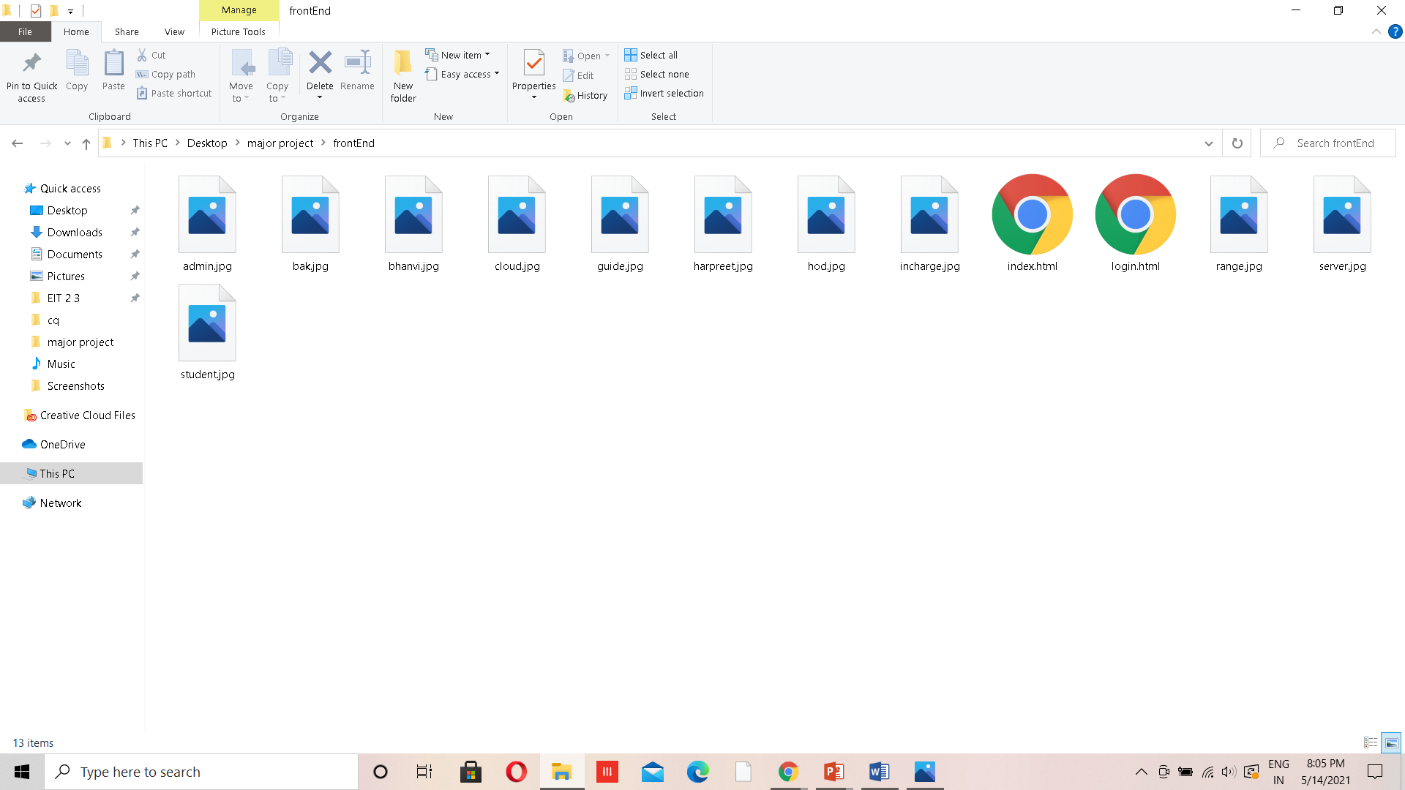
FILE STRUCTURE FOR FRONT END

Slide 14
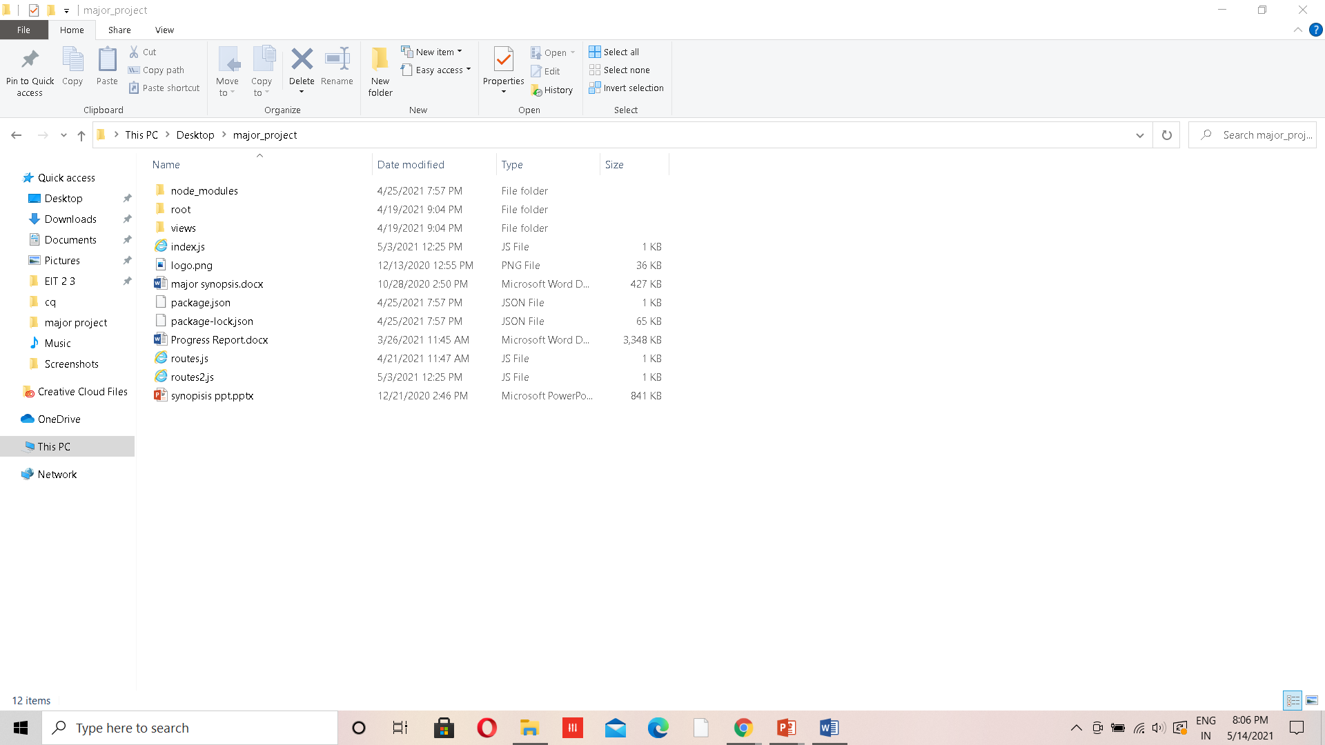
File Structure for Back End

Slide 15
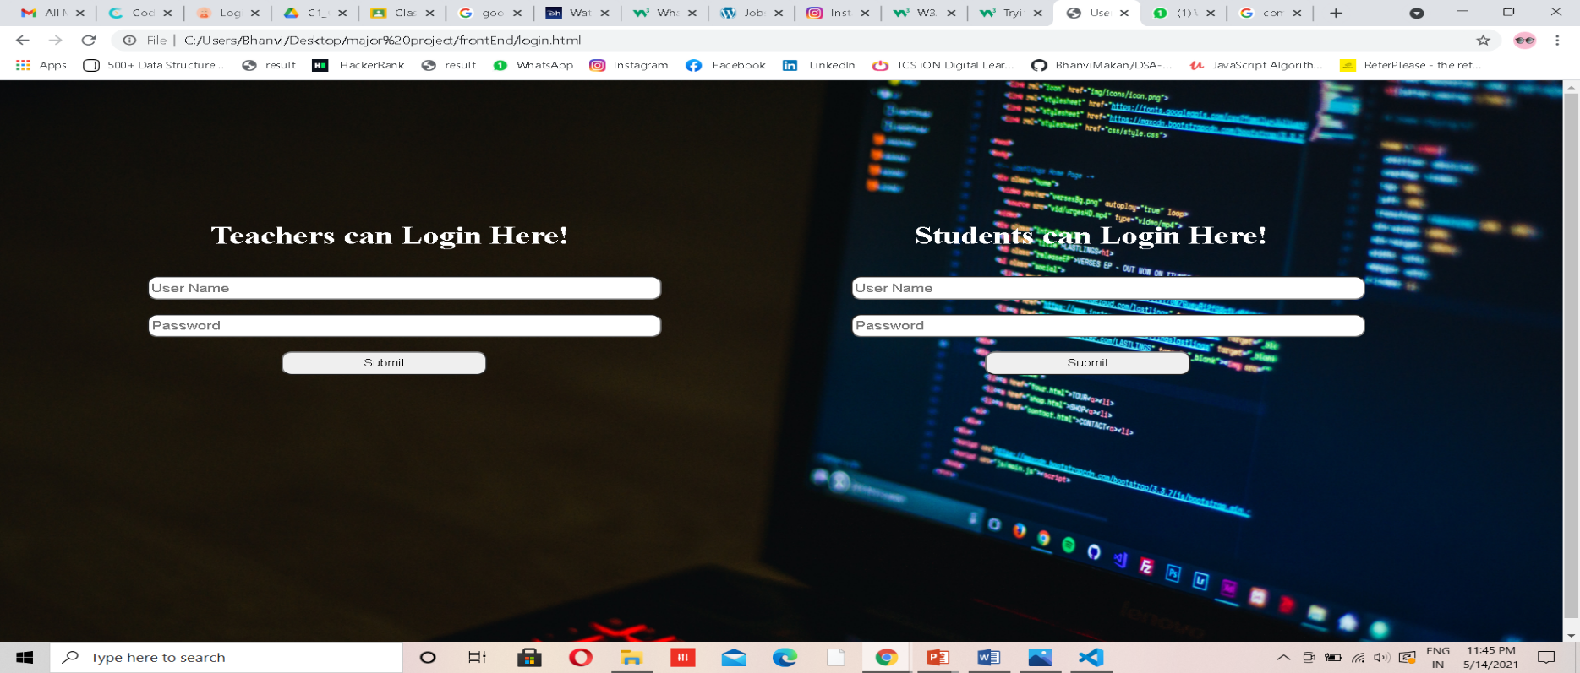
Other screenshots

Slide 16
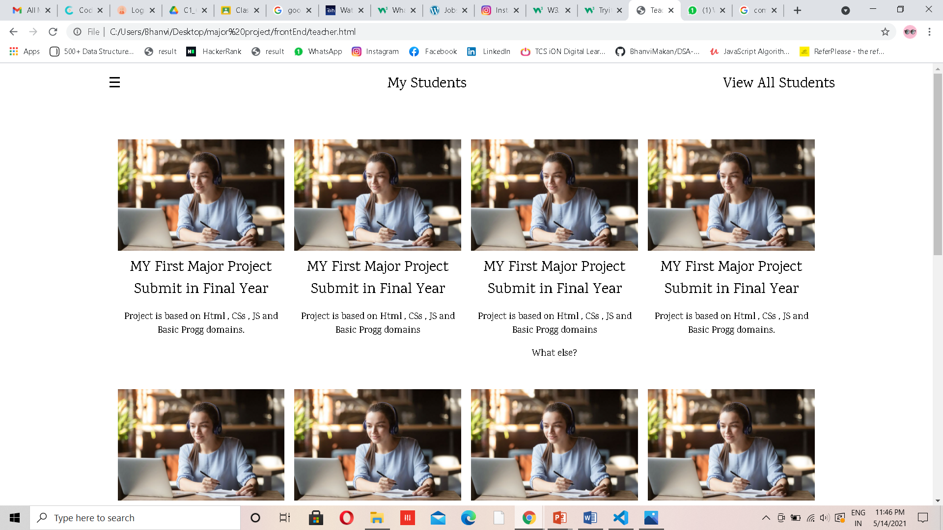

Slide 17
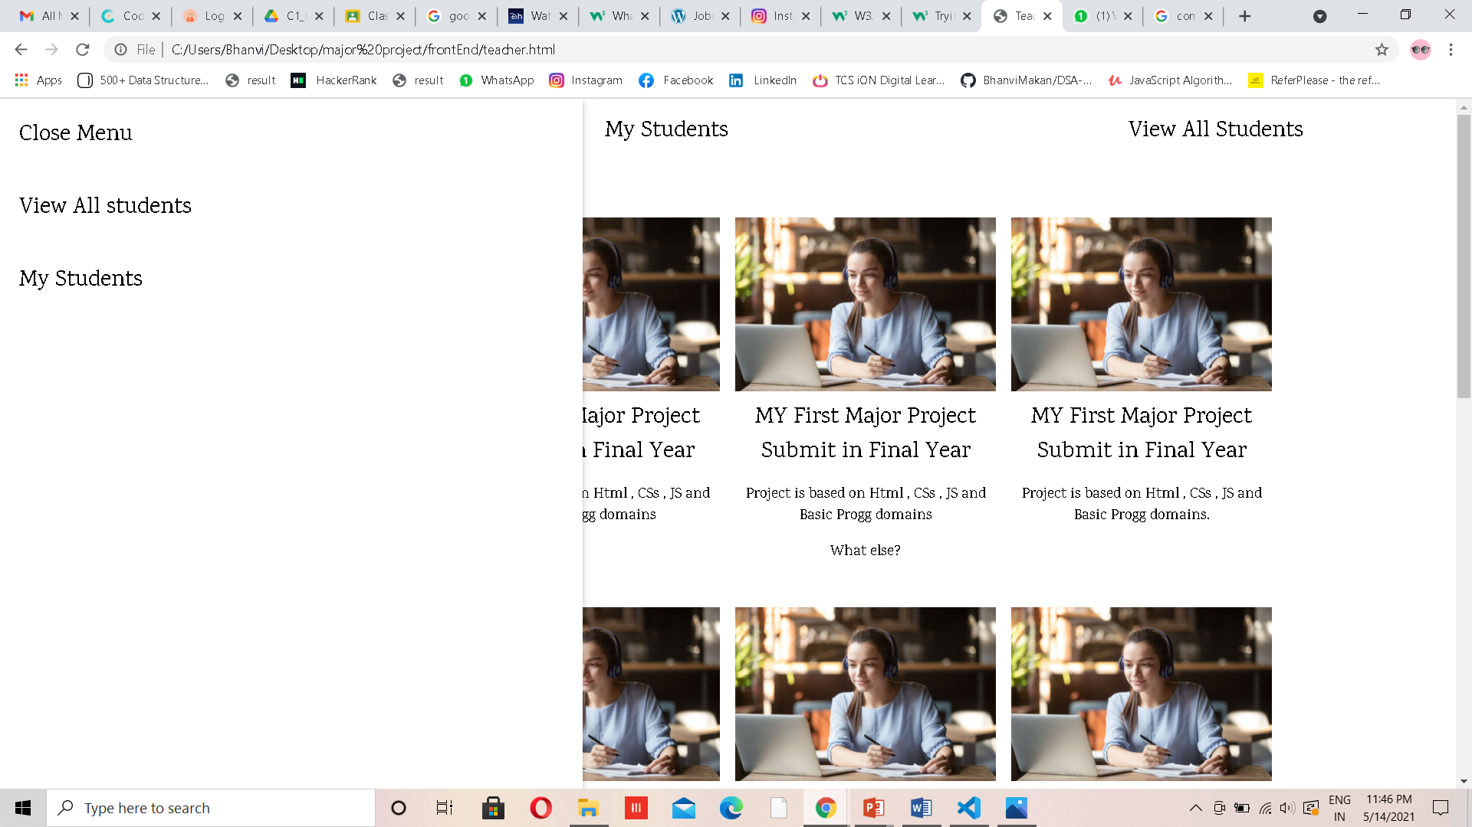

Slide 18
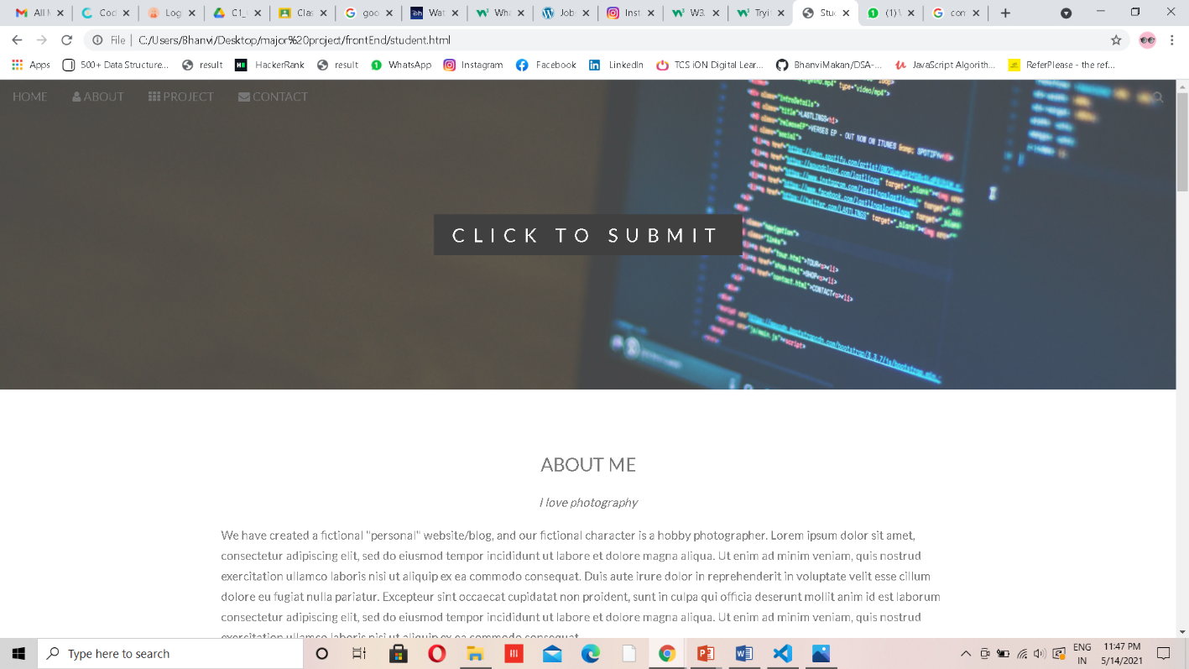

Slide 19
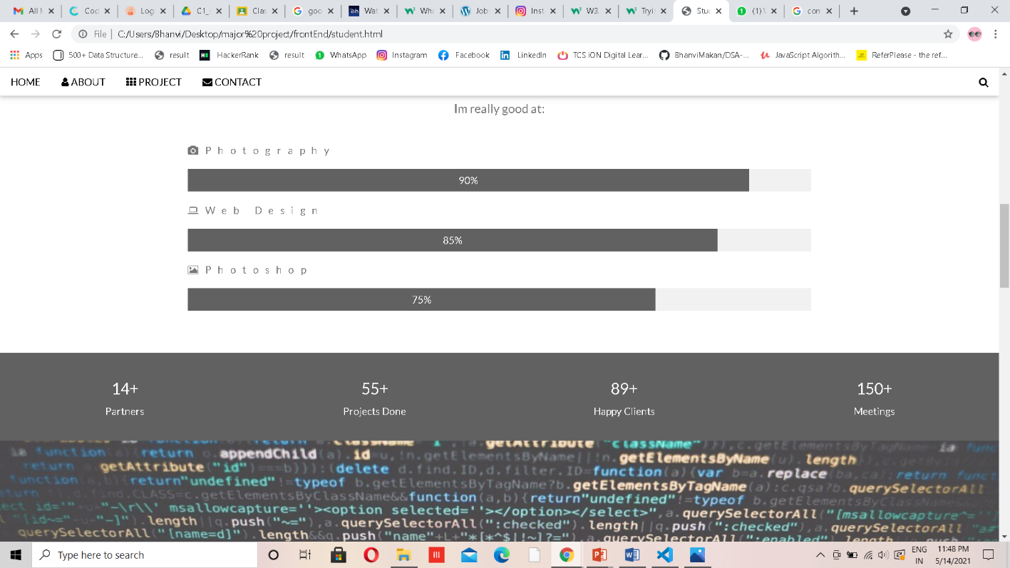

Slide 20
THANK YOU!

